Slide 1


The CLOUD WHO Learned to smile

Slide 2

I am so lonely……

Slide 3

Oh no every one looks so sad
I need water
Water is dried up

Slide 4
I can help them ! I can make it rain
I want to grow
I am soo thirsty…

Slide 5



Slide 6


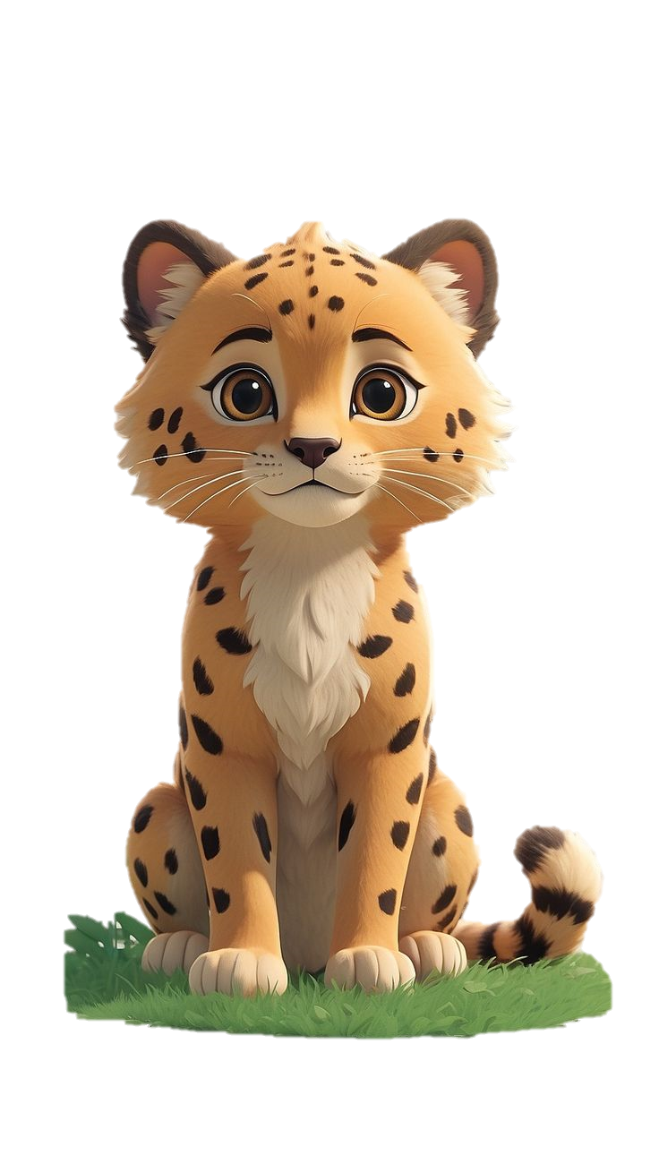
Everyone is sooo happyyyy
I am feeling fresh
Thank you for helping us

Slide 7

MORAL:
Helping others can bring you true happiness

